Slide 1
Study of growth of algae in polluted water bodies
Rohitha Ramkumar XI, Pavithra Praveen XI
PSBB Learning Leadership Academy
1

Slide 2
01
Table of contents
Here you could describe the topic of the section
01
Introduction
05
Result
02
Objectives
06
Conclusion
03
Study area
07
Acknowledgements
04
Materials and methods
08
References
Lake 2022
2

Slide 3
01
Introduction
Lake 2022
3

Slide 4
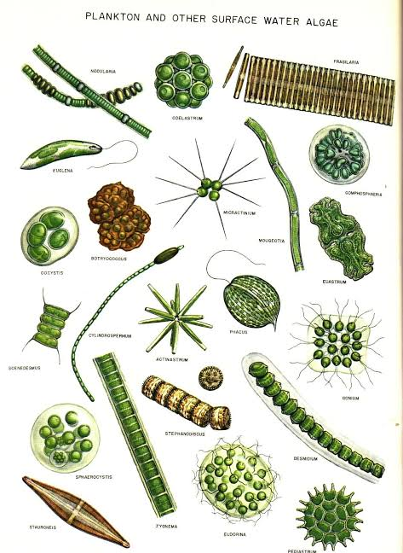
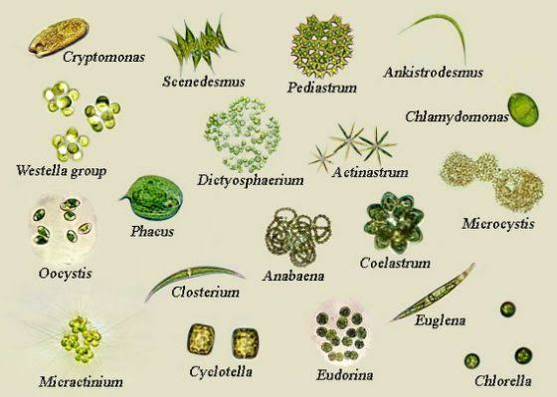
Algae
Photosynthetic, eukaryotic
Lack many cell type and tissues
Jean Pierre Étienne Vaucher
Industrial and traditional applications
Chlorophyll a primary pigment
Lake 2022
4

Slide 5
02
Objectives
Lake 2022
5

Slide 6
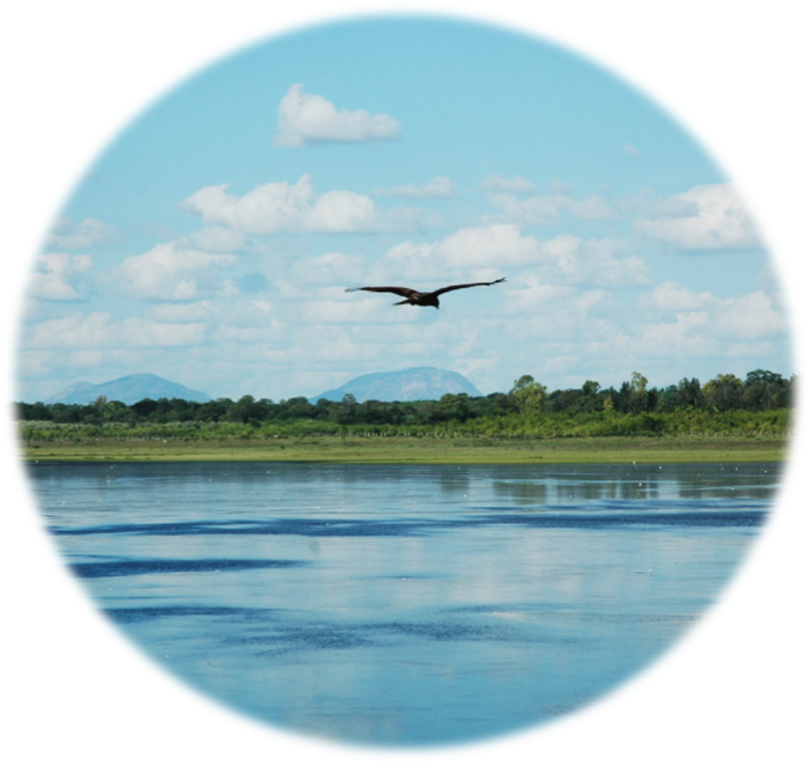
Study objectives
To compare and contrast pollution in two different lakes.
To study growth of algae in polluted lakes.
To establish relationship between growth of algae and dissolved
nutrients.
Lake 2022
6

Slide 7
03
Study area
Lake 2022
7

Slide 8
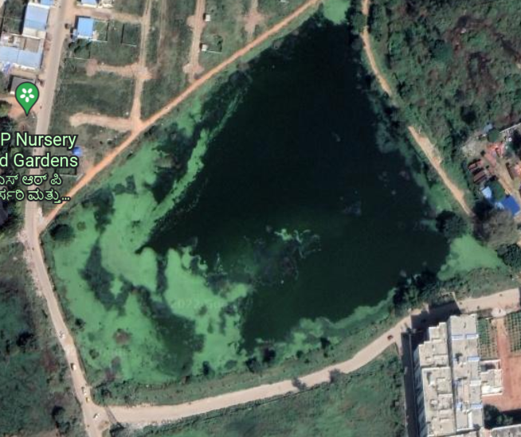
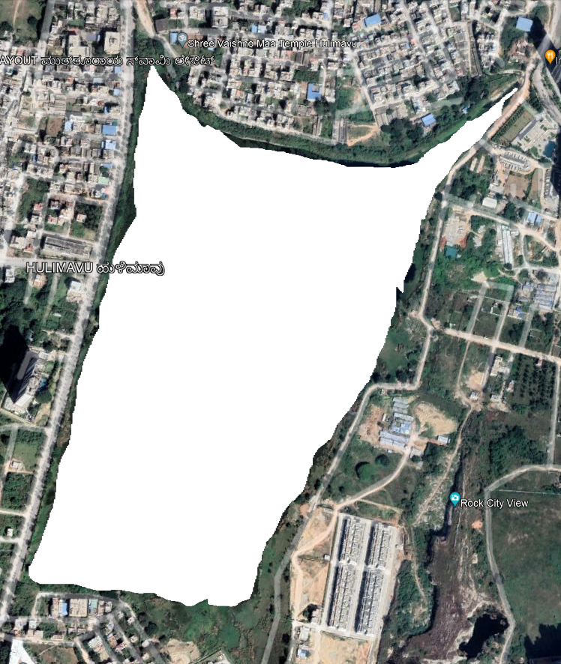
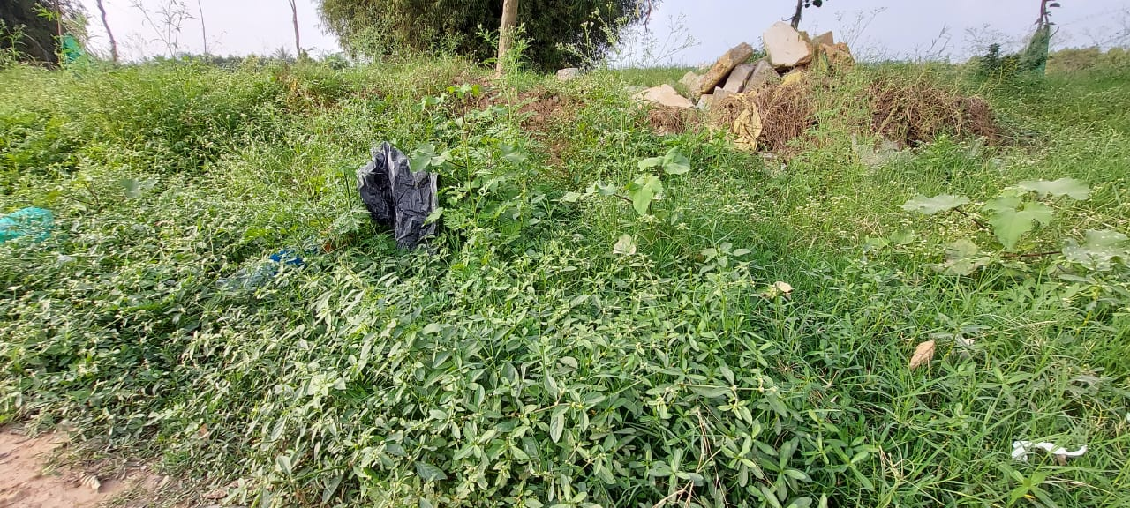
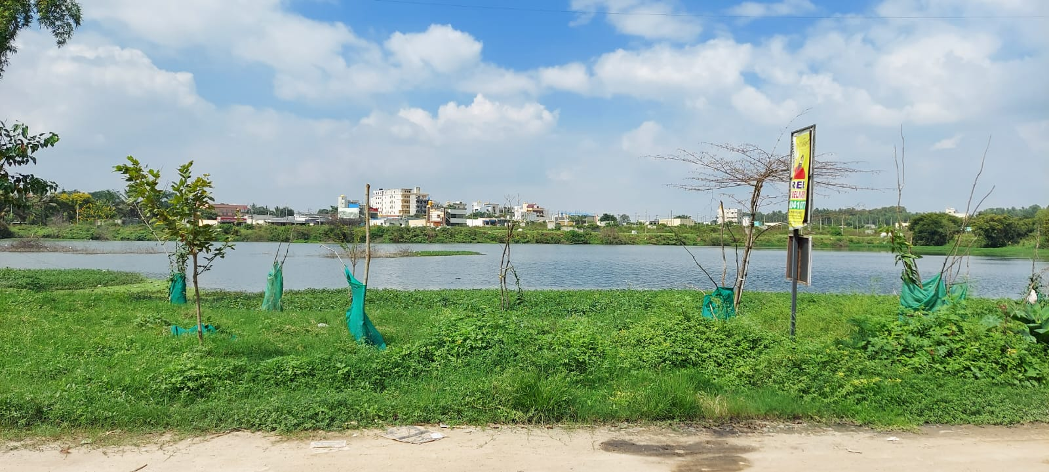
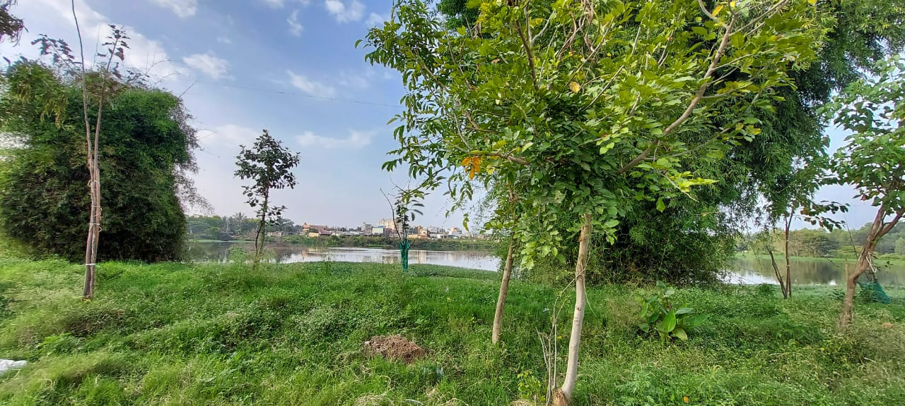
Chikkatogur Lake, Electronic City
Lake 2022
8

Slide 9
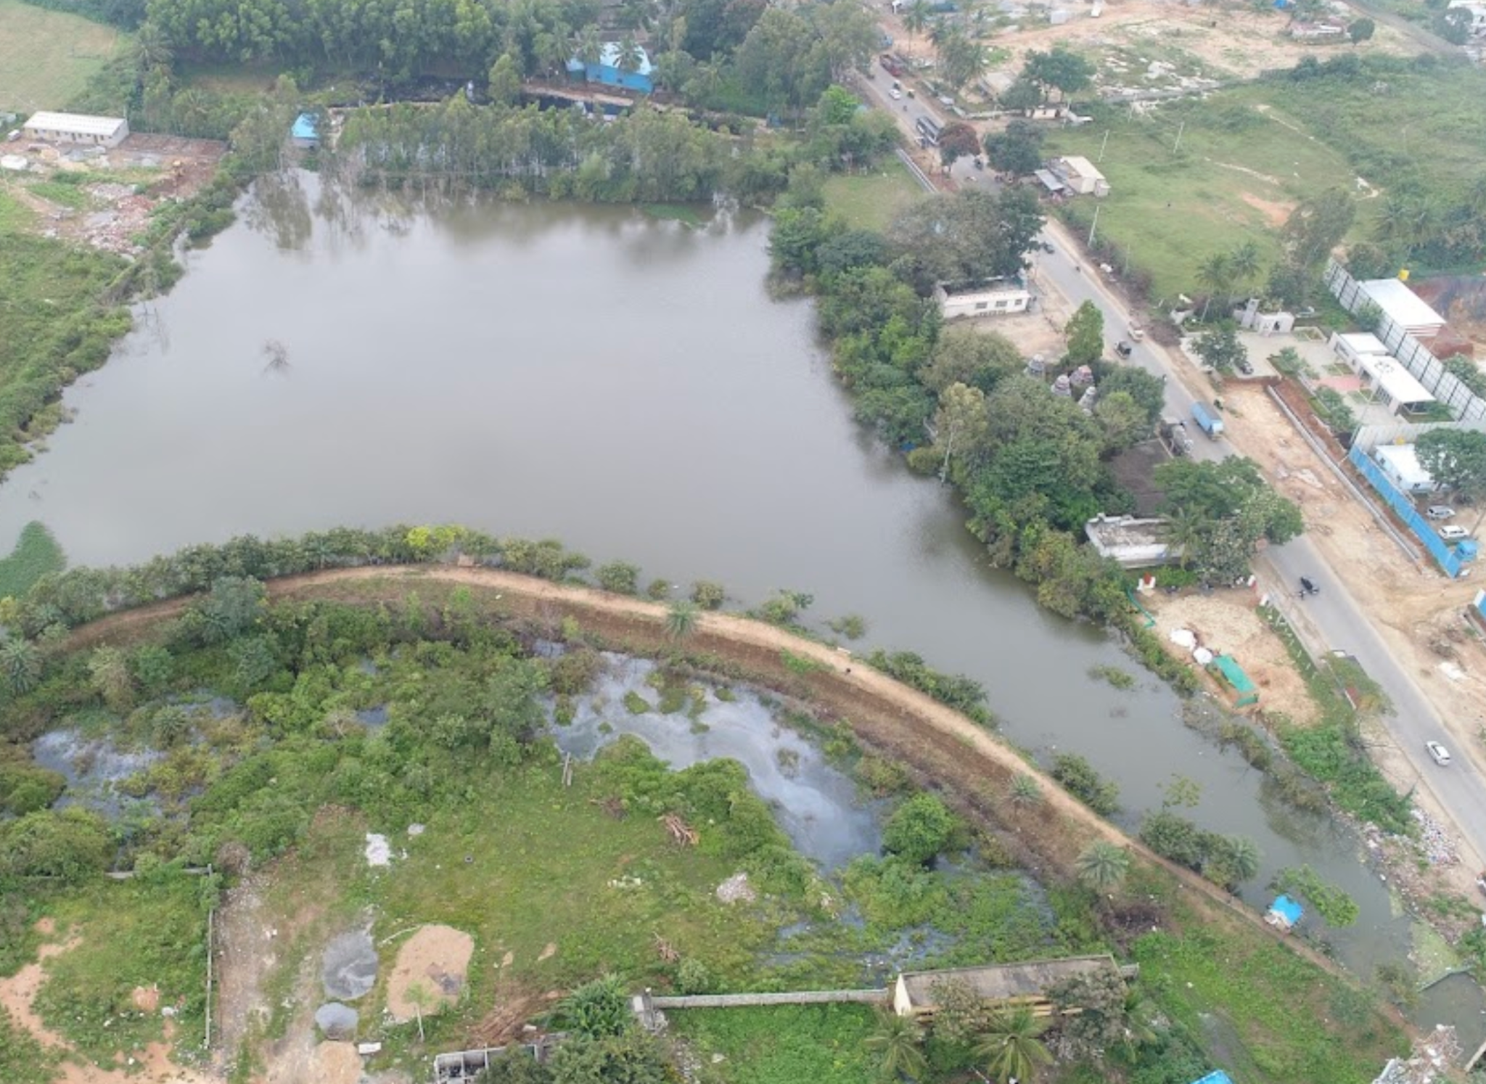
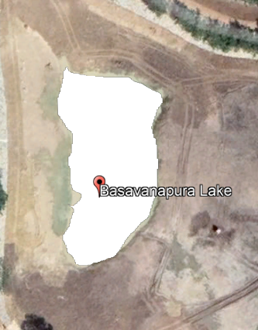
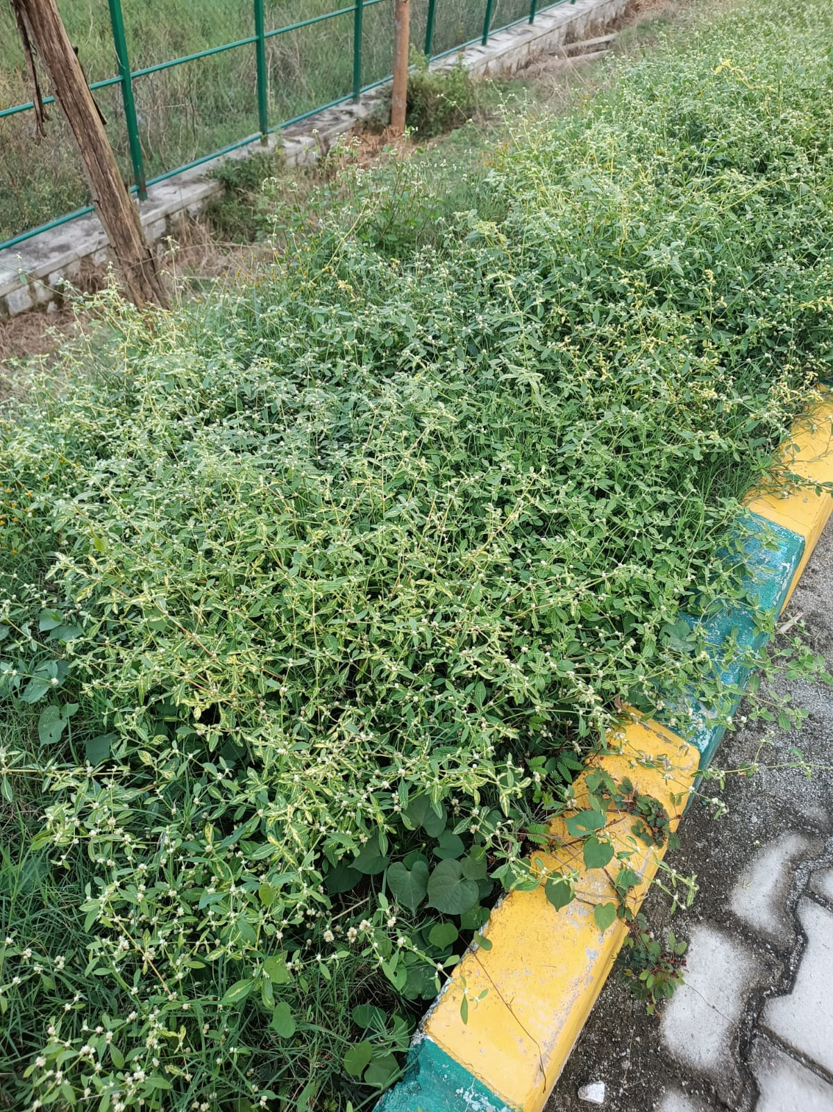
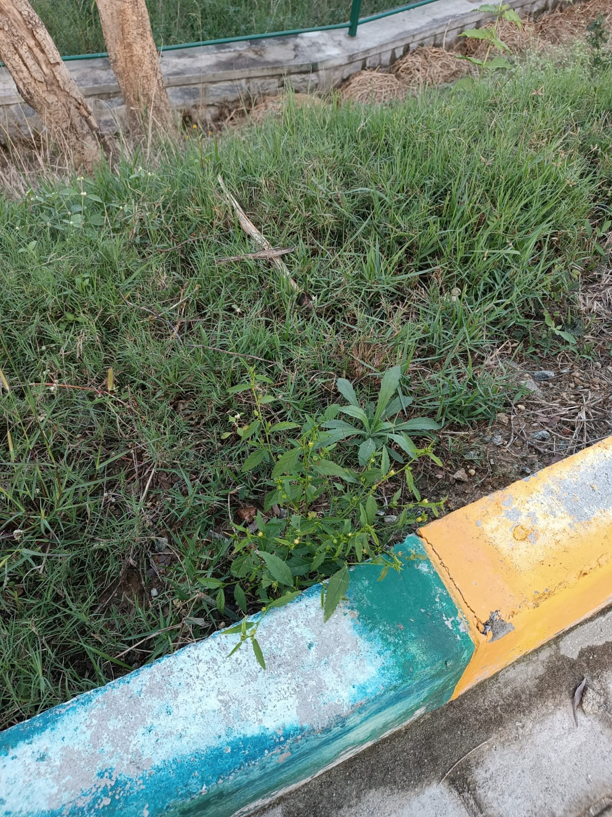
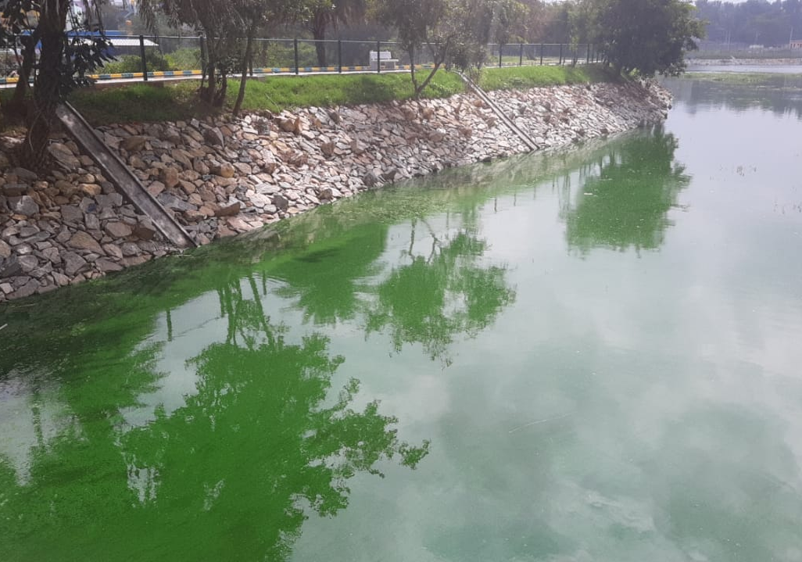
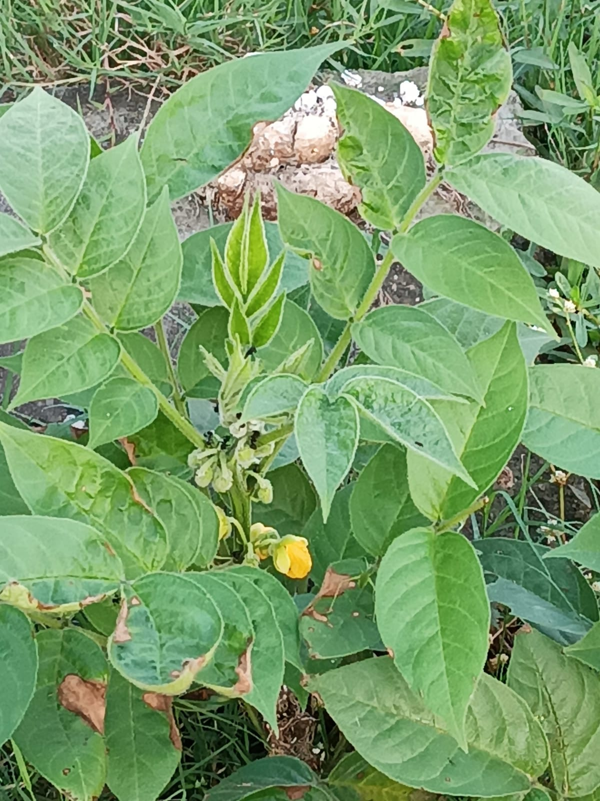
Basavanapura Lake, Gottigere, Bannerghatta Road
Lake 2022
9

Slide 10
04
Materials and methods
Lake 2022
10

Slide 11
Methodology
Manual collection of sample from different parts of the lake
Agar culture
Microscopic images
Quantitative analysis through titration
Lake 2022
11
Notes:
Algal blooms and eutrophication tend to increase the population of oxygen-consuming bacteria called decomposers that feed on dead algae.
The presence of such organisms increases the biochemical oxygen demand (BOD) of the water, a measure of the amount of dissolved oxygen they consume.
The higher the BOD, the less dissolved oxygen is available for other organisms, so it is a measure of pollution.
The biochemical oxygen demand (BOD) of the water tends to increase where algal blooms are present.
low Ca2+ loading promoted both COD and nutrients removal.

Slide 12
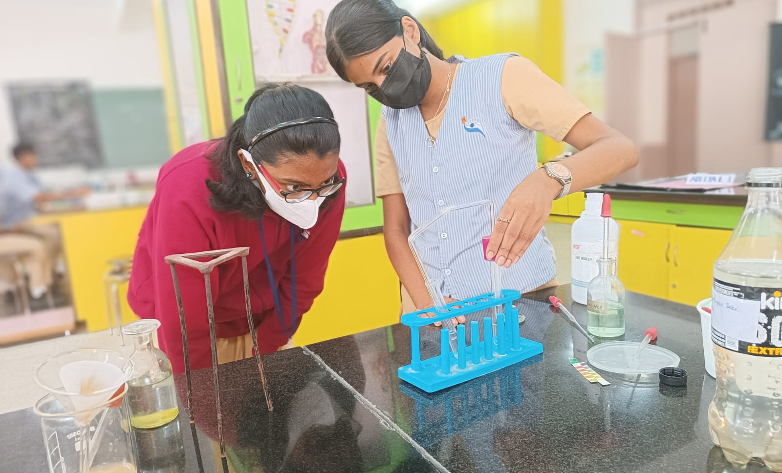
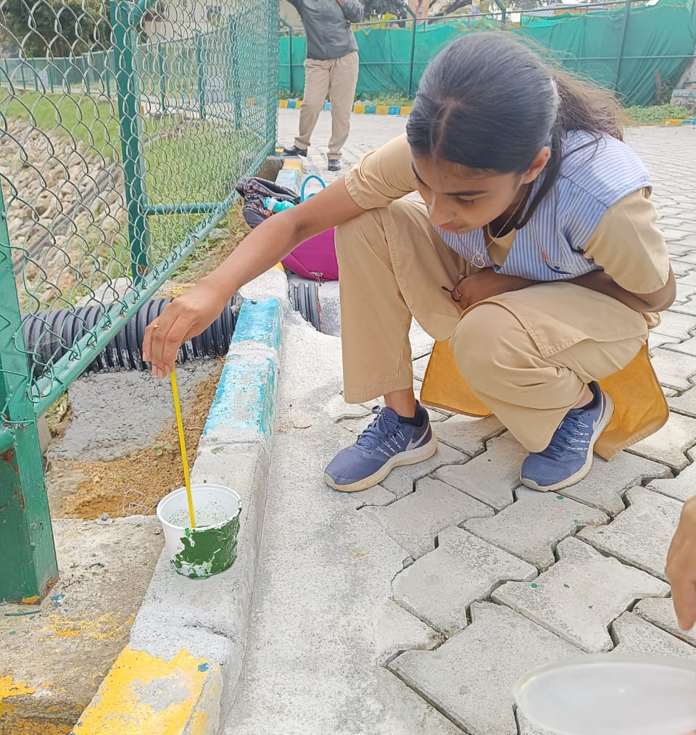
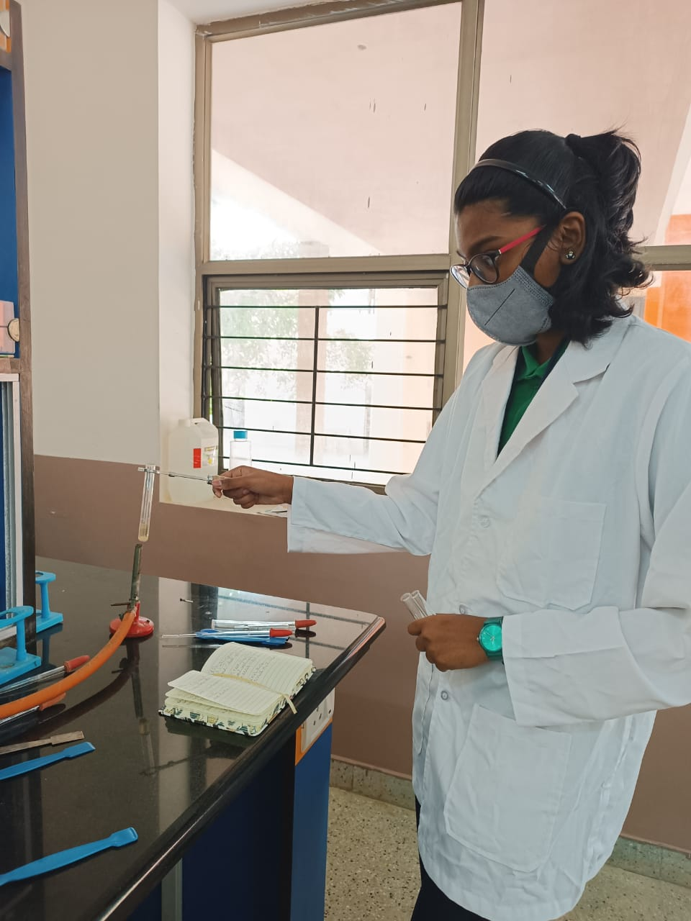
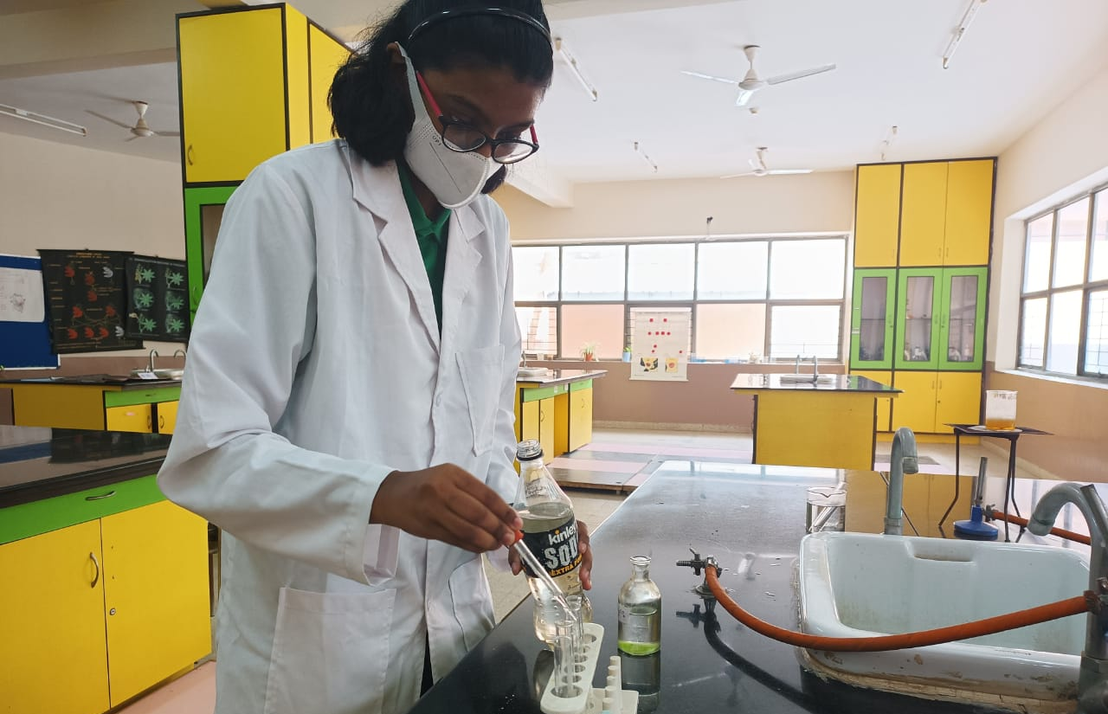
Our experiments
Lake 2022
QUALITATIVE ANALYSIS
12

Slide 13
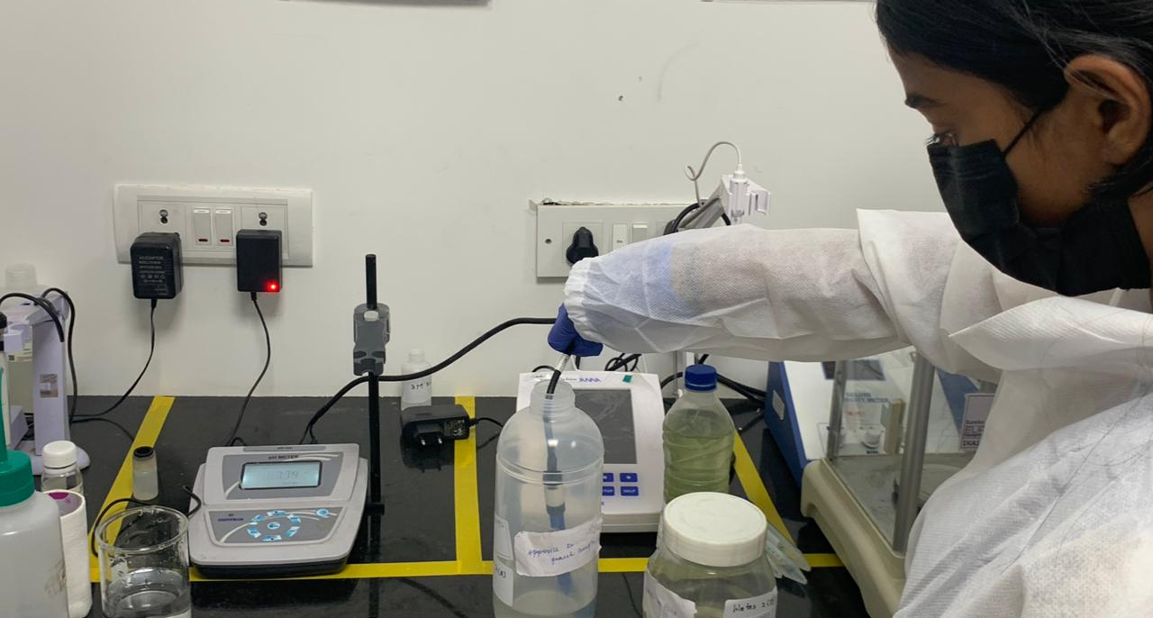
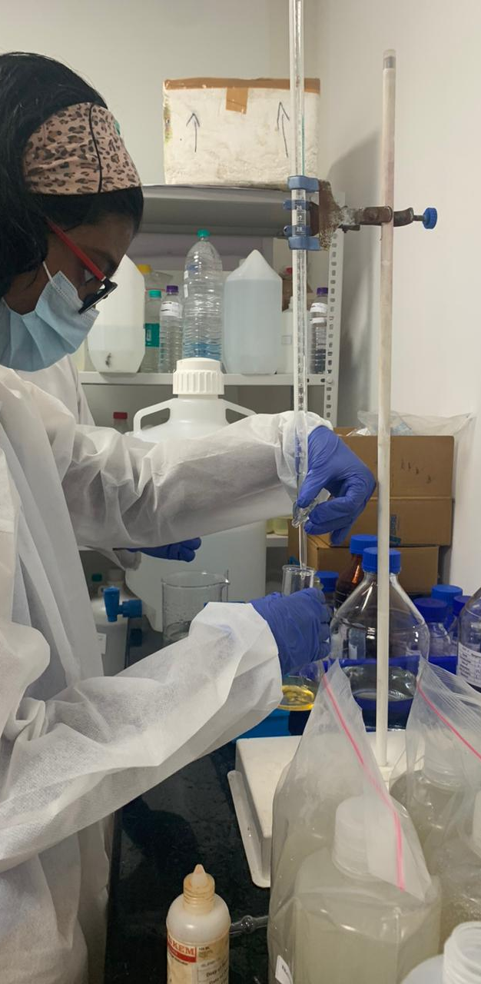
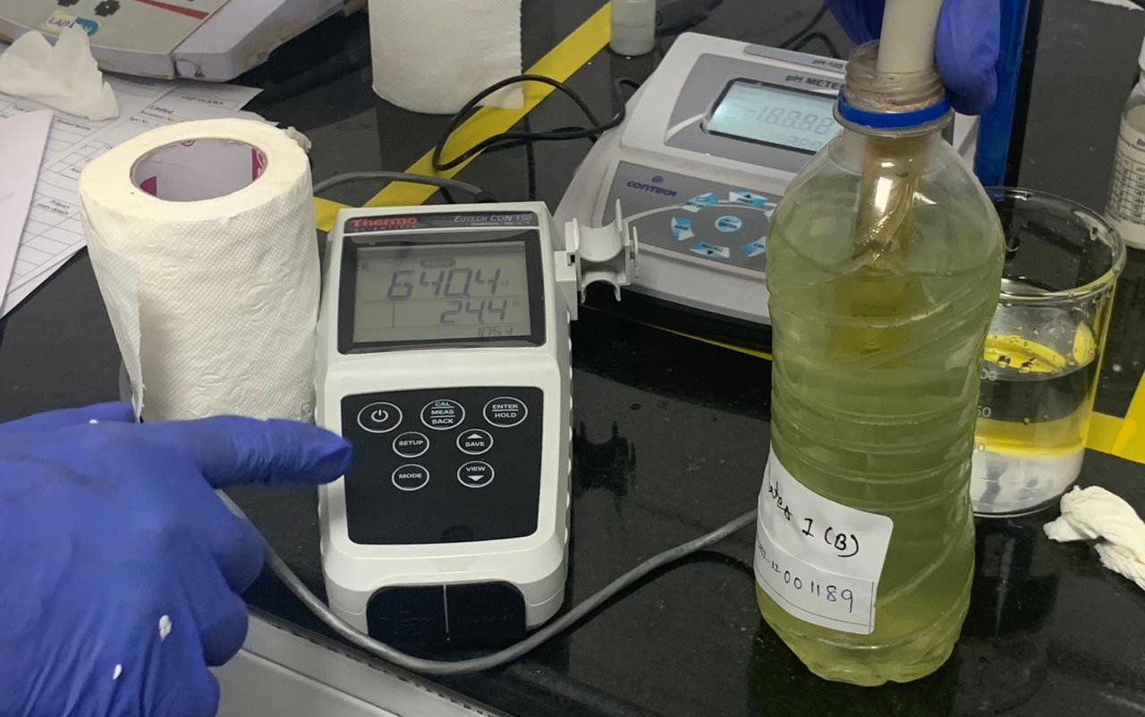
pH
Lake 2022
COD
Alkalinity
13
ELECTRICAL CONDUCTIVITY

Slide 14
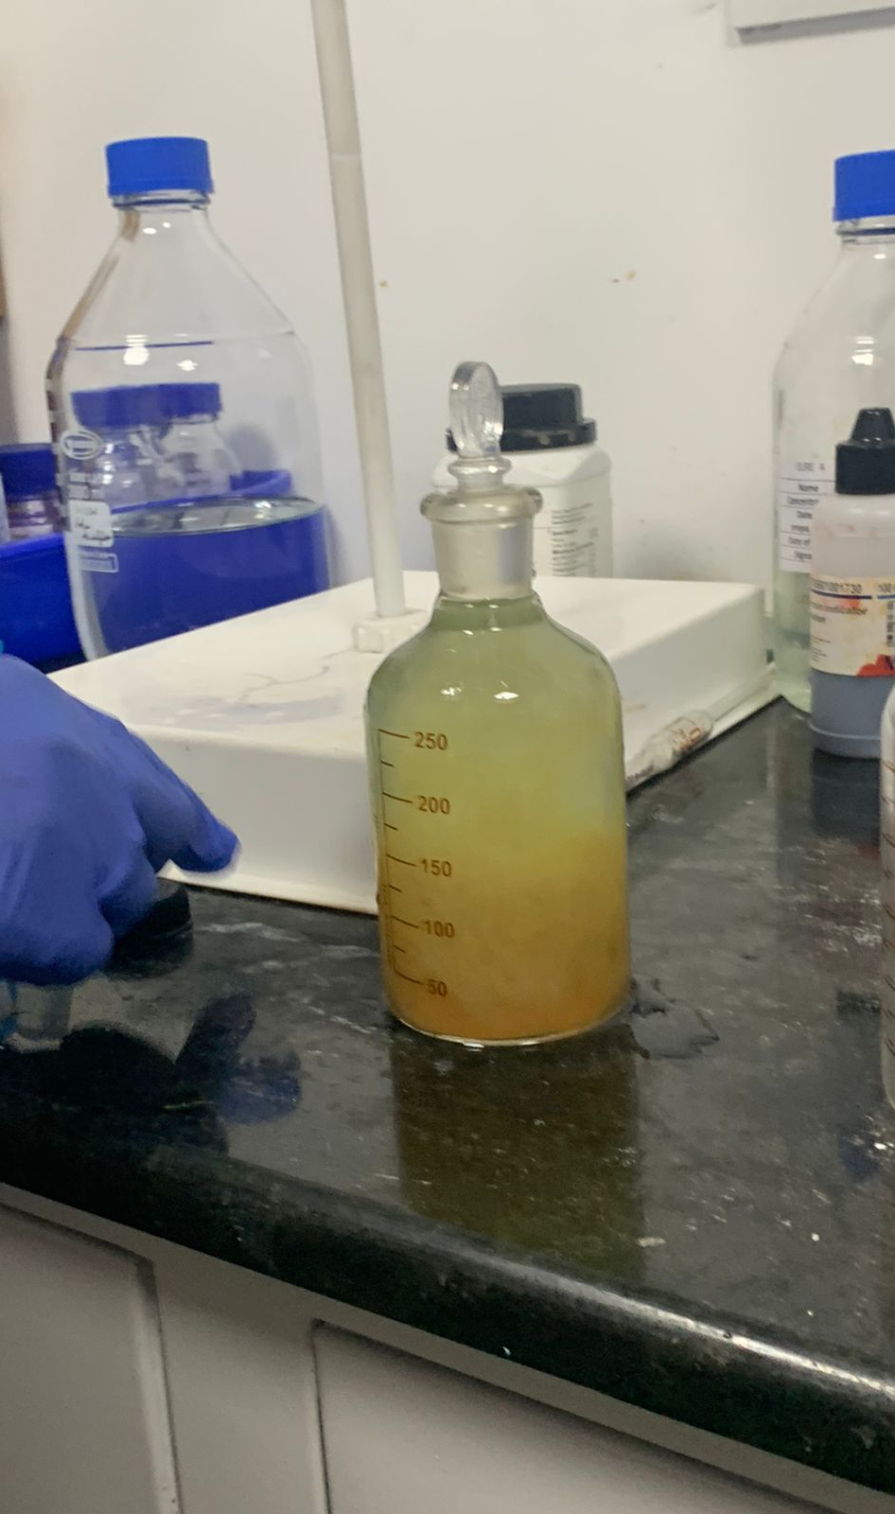
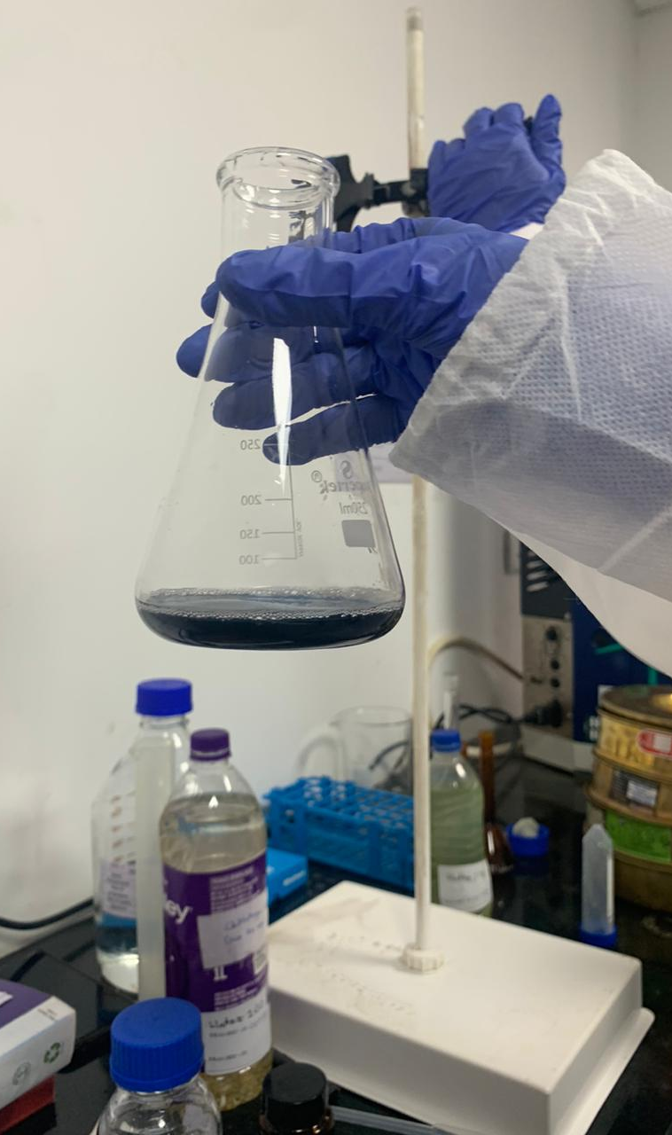
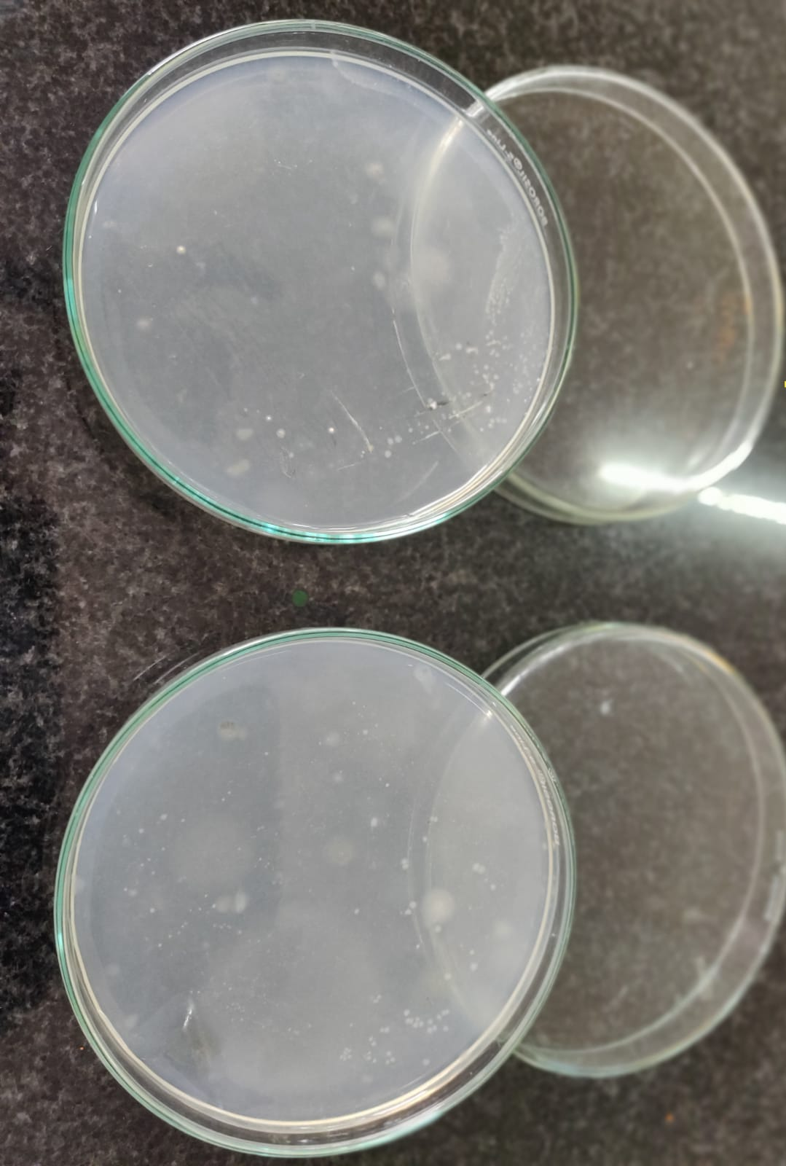
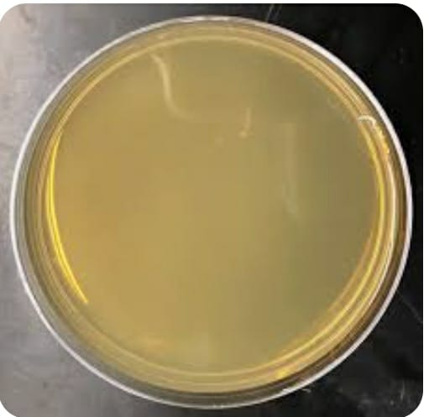
DISSOLVED OXYGEN
ALGAE CULTURE
HARDNESS
14
Lake 2022

Slide 15
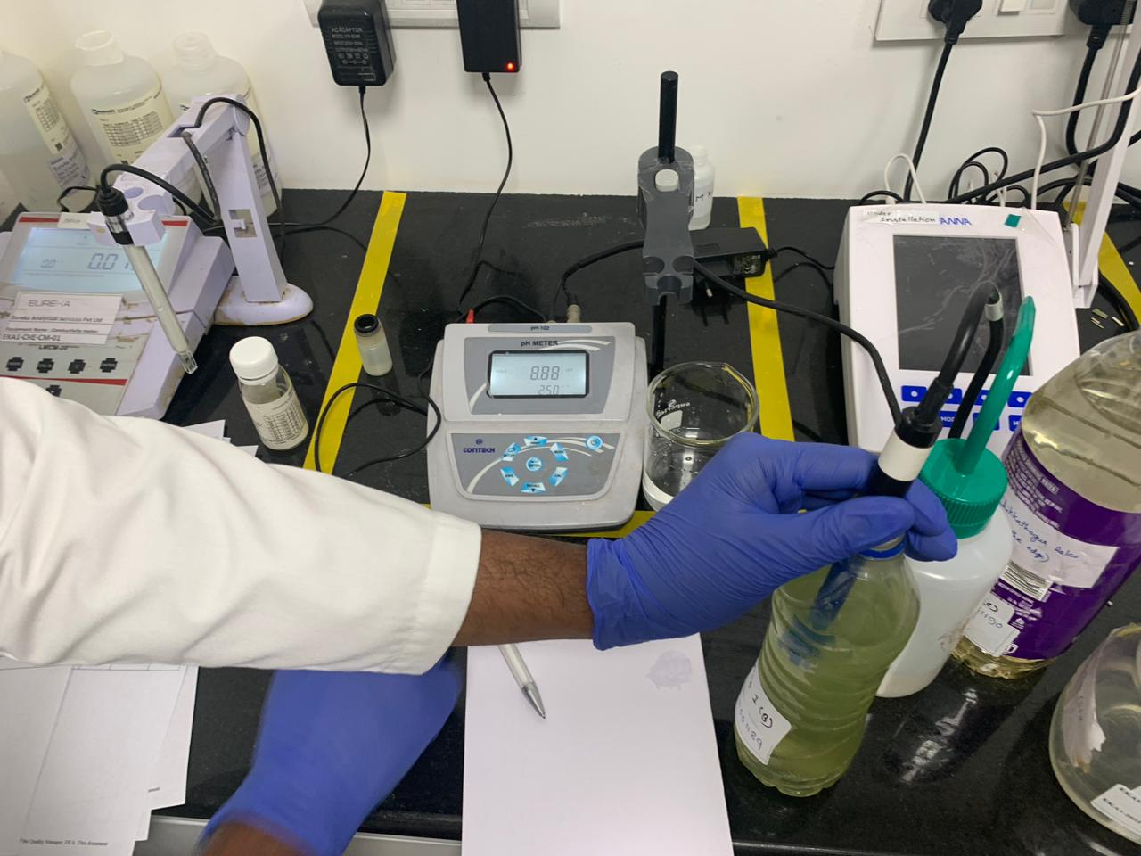
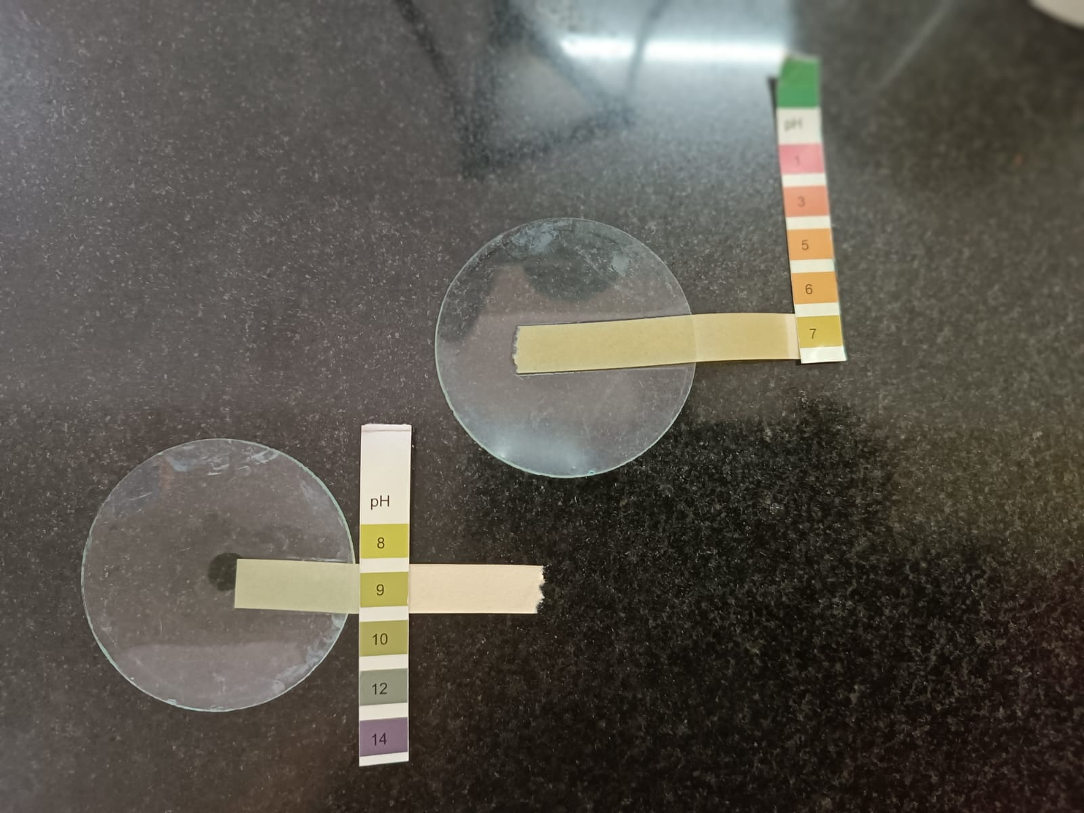
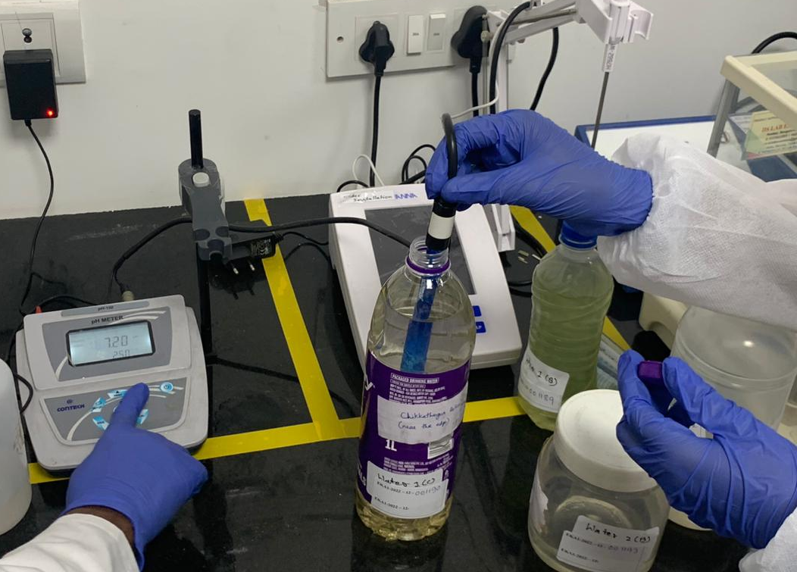
pH
BasavanapuraLake
Chikkatogur Lake
Chikkatogur Lake
Basavanapura Lake
Lake 2022
15

Slide 16
05
Result
Lake 2022
16

Slide 17
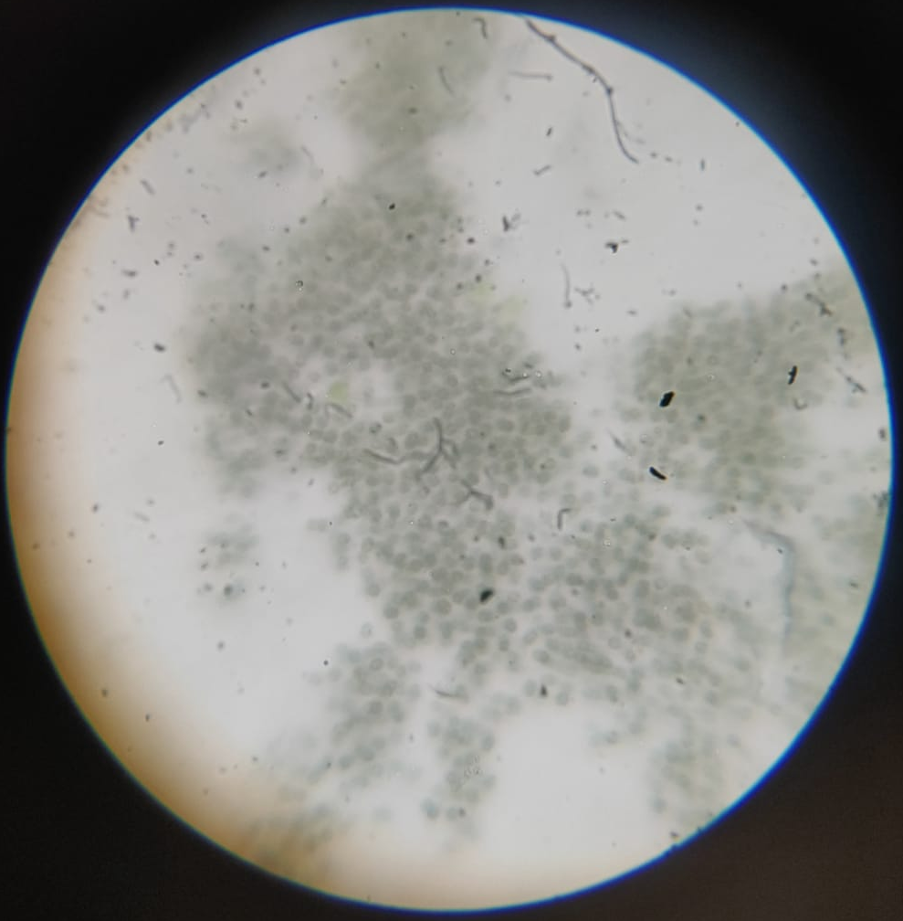
Algae found in Basavanapura Lake
Volvox
Chlamydomonas
Dictyosphaerium
Mycelium
Lake 2022
17
Notes:
microcystis

Slide 18
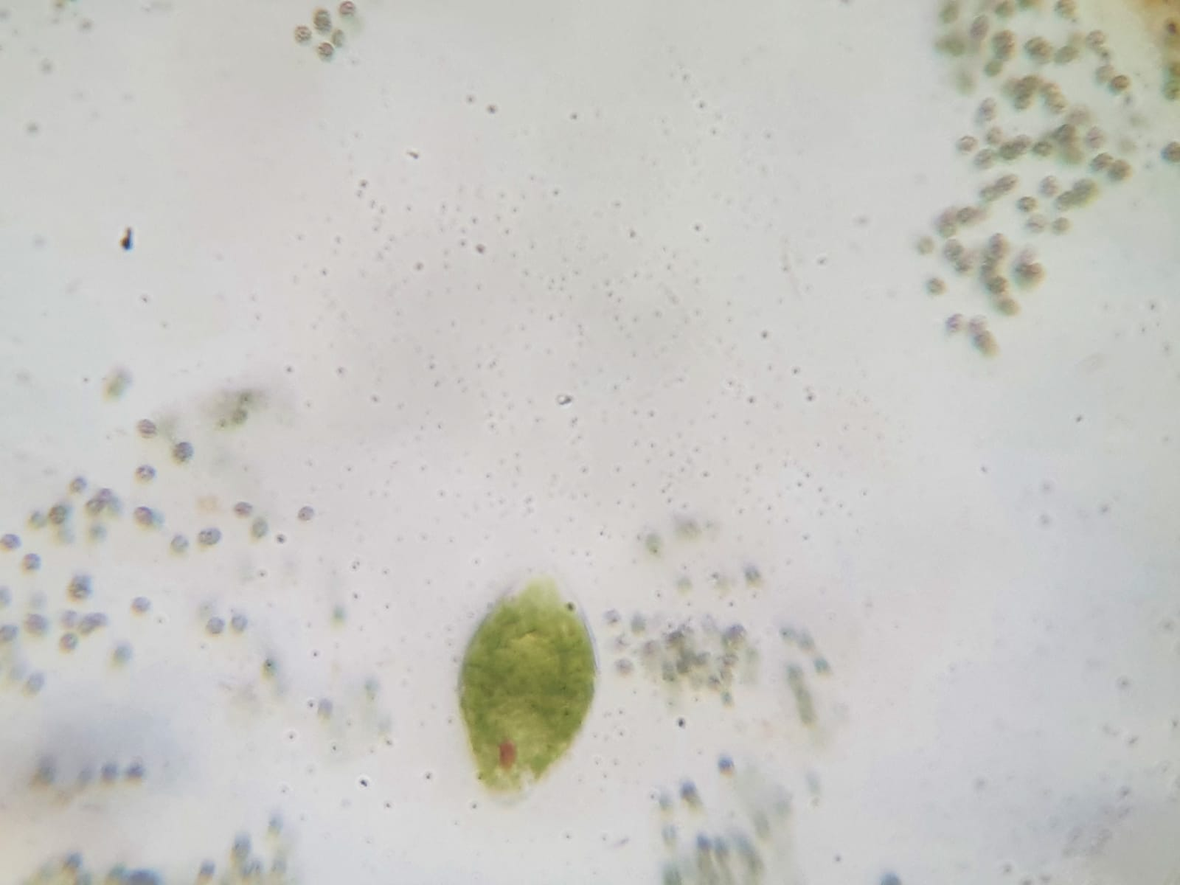
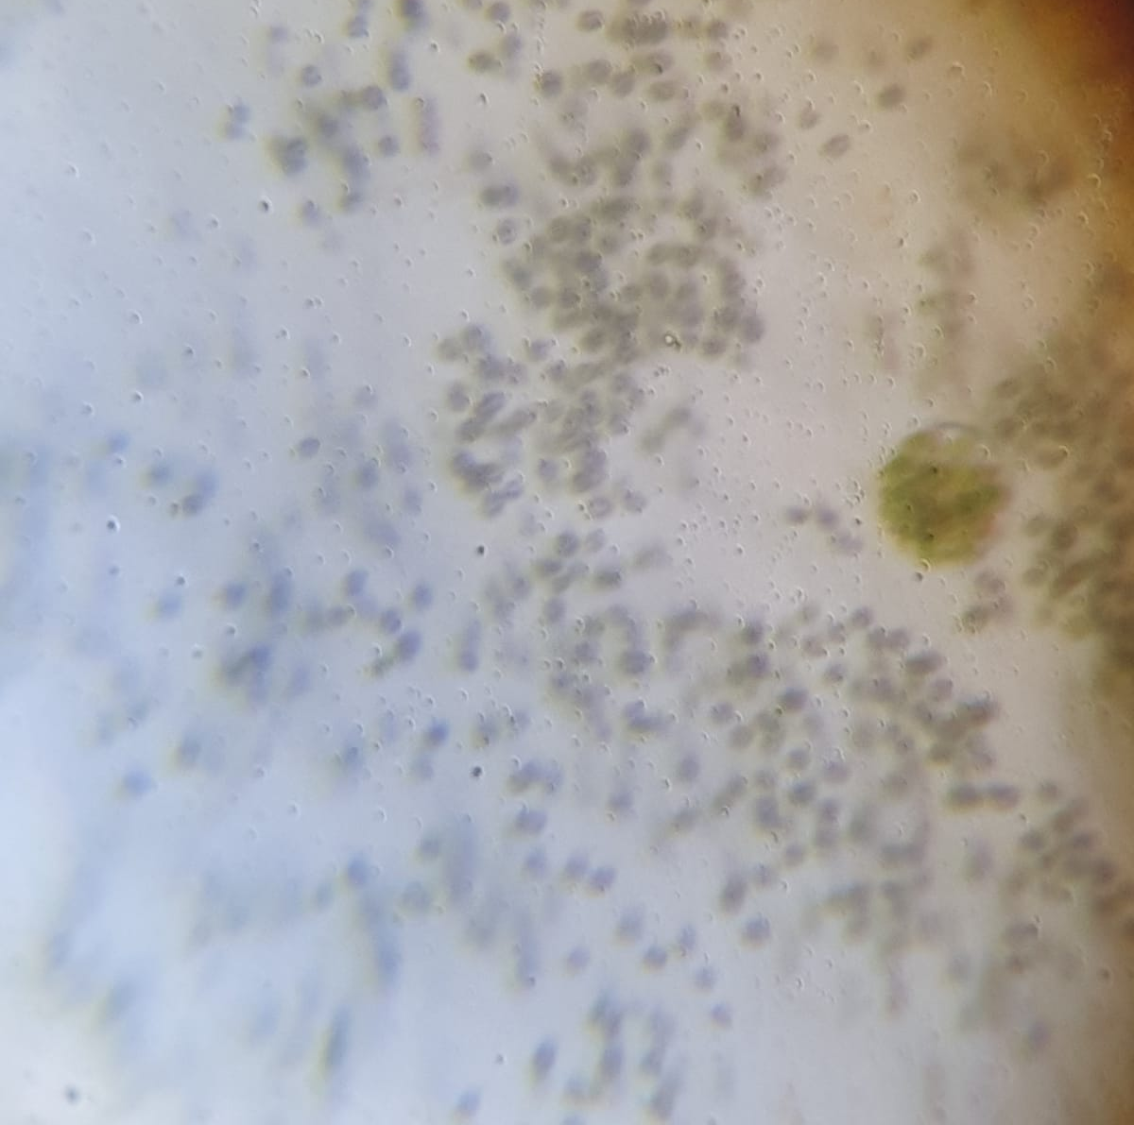
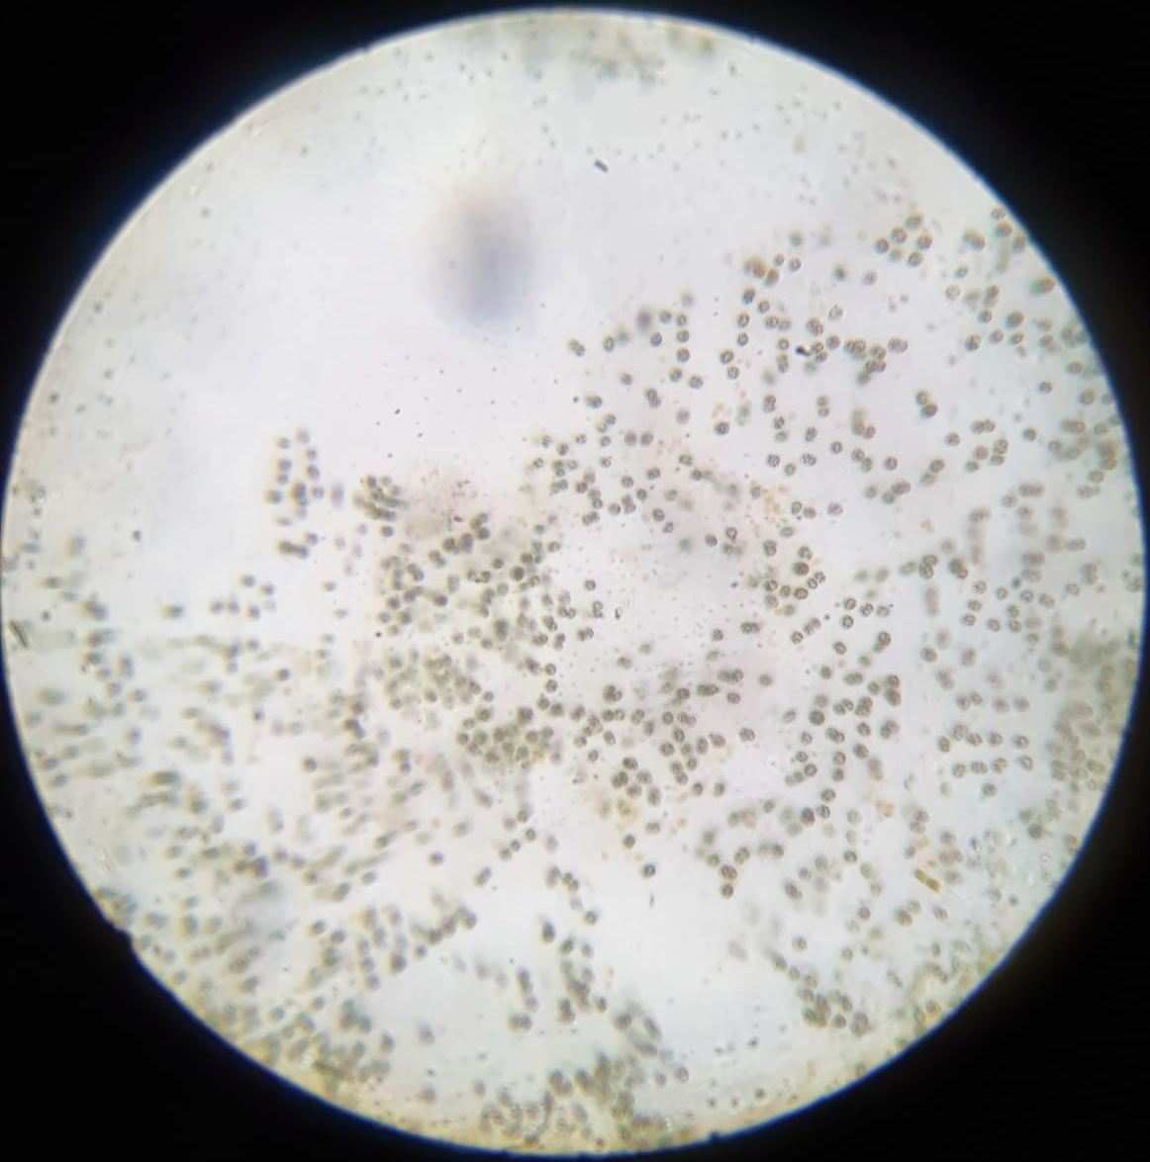
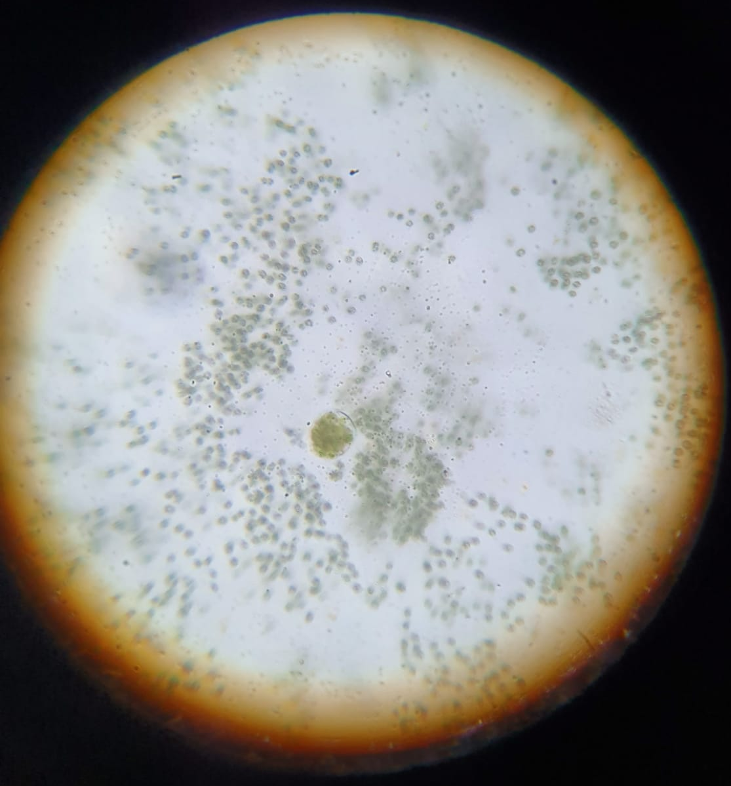
Algae found in Chikkatogur Lake
Chlamydomonas
Volvox
Oscillatoria
Dictyosphaerium
Lake 2022
18
Notes:
clamydomonas

Slide 19
Quantitative Analysis Result
Presence of | Unit | Chikkathogur Lake | Basavanapura Lake
Temperature | oC | 26 | 28.5
pH | NA | 7.20 | 8.88
Calcium | mg/L | 96.48 | 67.05
Chlorides | mg/L | 72.5 | 83.5
Magnesium | mg/L | 9.92 | 21.82
DO | mg/L | 5.4 | 5.6
COD | mg/L | 76.8 | 134.4
BOD | mg/L | 18 | 36.0
EC | μs/cm | 784.7 | 640.4
Alkalinity | mg/L | 150 | 150
19
Lake 2022

Slide 20
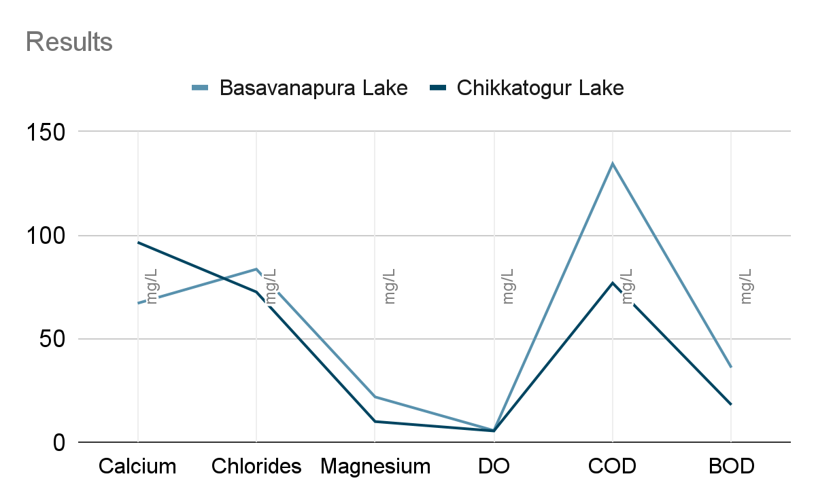
Quantitative Analysis Result
Lake 2022
20

Slide 21
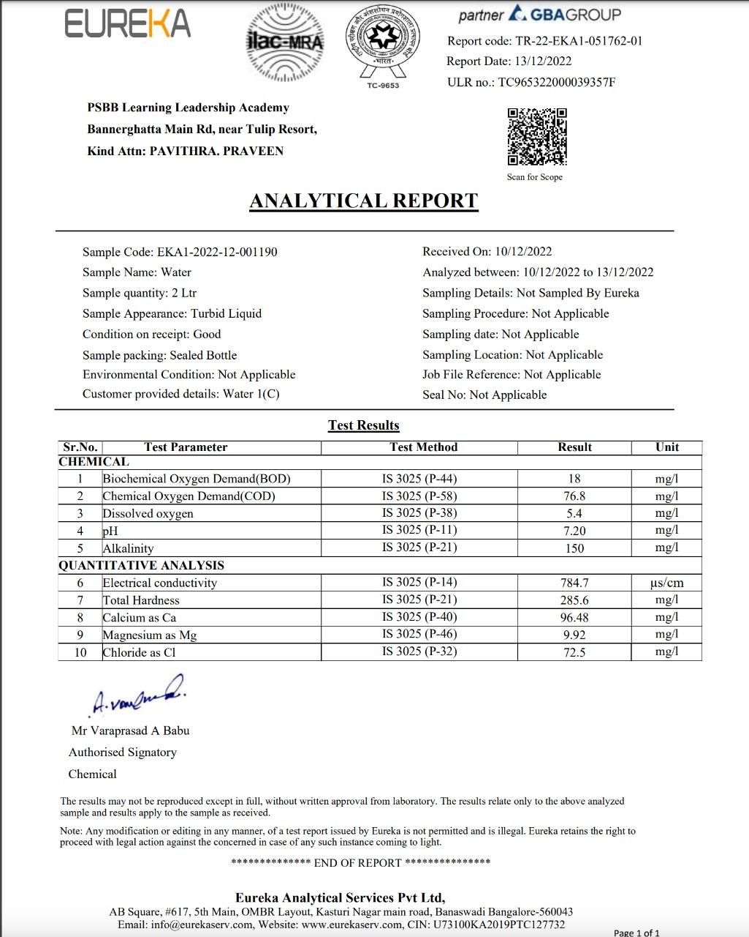
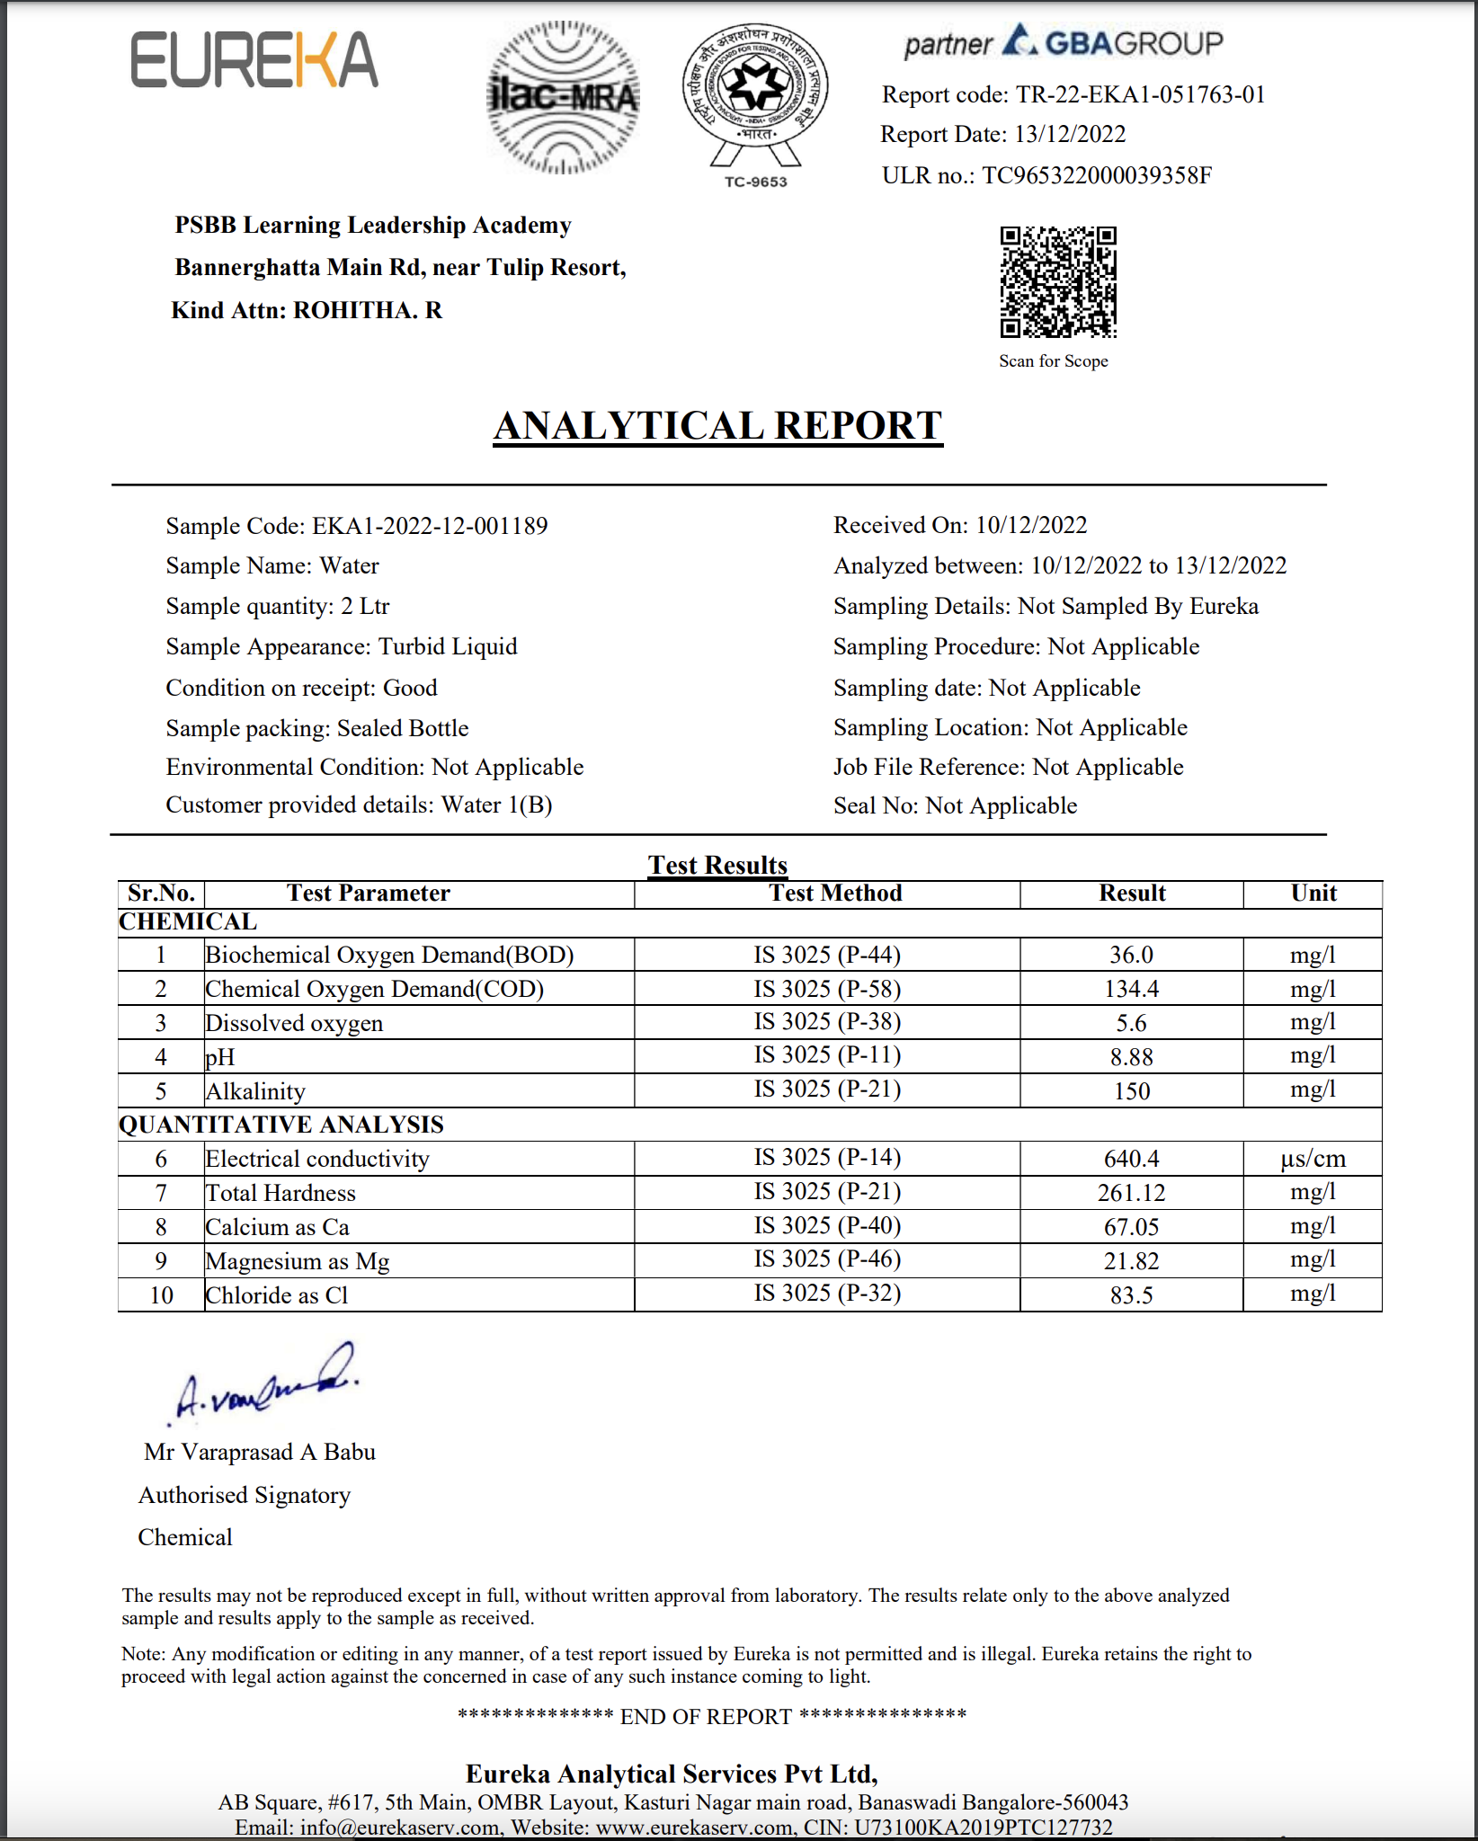
Quantitative Analysis Lab Result
Chikkatogur lake
Basavanapura lake
Lake 2022
21

Slide 22
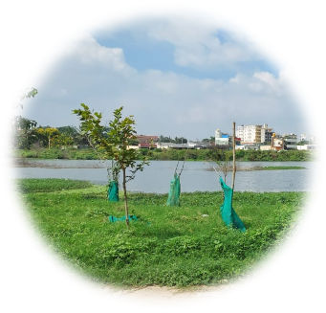
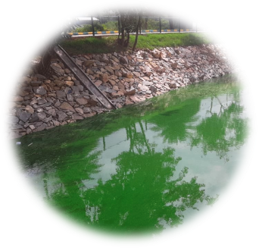
Analysis
Chikkatogur Lake
Basavanapura Lake
pH is almost neutral
Low presence of Chlorides and Magnesium
High amount of calcium
Low COD and BOD
High electrical Conductivity
pH is alkaline
High presence of Chlorides and Magnesium
Low amount of calcium
High COD and BOD
Lower electrical conductivity
Lake 2022
22

Slide 23
06
Conclusion
Lake 2022
23

Slide 24
Conclusion
Similar algae are found in both lakes due to similarity in temperature, pH, DO and alkalinity.
Due to increase in BOD and COD and decrease in Calcium, there is more algae growth in Basavanapura Lake.
Chikkatogur Lake has less algae growth due to more presence of Calcium and less BOD and COD.
Lake 2022
24

Slide 25
07
Acknowledgement
Lake 2022
25

Slide 26
We would like to extend gratitude to ENVIS, IISc for giving us the golden opportunity to do research in the school environment and to present our findings. We would like to thank Eureka Analytical Services for helping us conduct experiments and record our results.
Lake 2022
26

Slide 27
08
References
Lake 2022
27

Slide 28
Bibliographical references
http://userhome.brooklyn.cuny.edu
https://www.sciencedirect.com
https://iopscience.iop.org
www.researchgate.net
https://sciencing.com
https://digital.library.unt.edu
https://biologyeducare.com
Lake 2022
28

Slide 29
Thank you
Lake 2022
29

